Slide 1
Object oriented programming
Iván Guerrero Román

Slide 2
Session #3
Topics
General concepts of object-oriented programming.
Preliminary concepts of structured programming.
Concepts of class, object, method, and attribute
Concepts of abstraction, encapsulation, and message passing.
UML class diagrams

Slide 3
Object oriented programming (OOP)

Slide 4
Definitions
Class: Generalization that contains characteristics and behaviors of a series of theoretical objects.
Characteristics: Represented as attributes / properties
Behaviors: Represented as methods / functions
Object: Instance of a class.
In general, a class uses objects in different ways
As attributes
As parameters of a method
As elements inside the body of a method

Slide 5
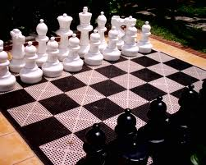


Examples
Take an object that you carry at the moment
Identify the class of objects to which it belongs.
List 5 attributes that share the objects of the class.
List 3 methods that represent functions that can be performed by objects in the class.

Slide 6
UML Class diagrams
UML: Unified Modeling Language
Language to model classes and interactions between them
Class diagrams
Represent class and their interactions
Attributes’ name
Data type
ClassName
Person
Attributes
int age
+ String name
Return data type
Method’s name
Methods
+ Person( )
+ void readEmail( )
+ boolean move( String place)
Access modifiers
Parameters

Slide 7
General structure of a class in Java
package packageName;
import completeClassName;
public class ClassName {
//Attributes
accessModifier dataType name;
//Methods
accessModifier returnDataType name(dataType name, …) {
//Method’s body
}
}

Slide 8
General structure of a class in Java
package packageName;
import completeClassName;
public class ClassName {
//Attributes
accessModifier CLASS OBJECT_NAME;
//Methods
accessModifier CLASS name(CLASS OBJECT_NAME, …) {
//Method’s body
}
}

Slide 9
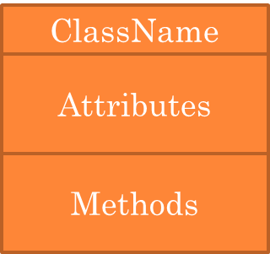
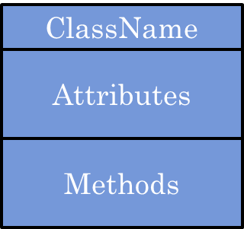
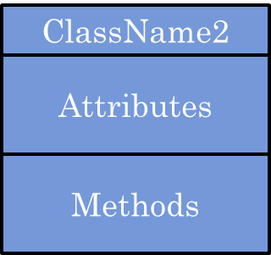
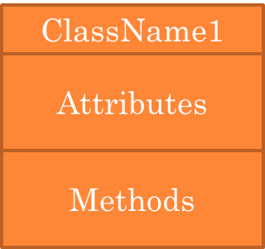
package1
package2
package package2;
import package1.ClassName1;
public class ClassName2 {
}

Slide 10
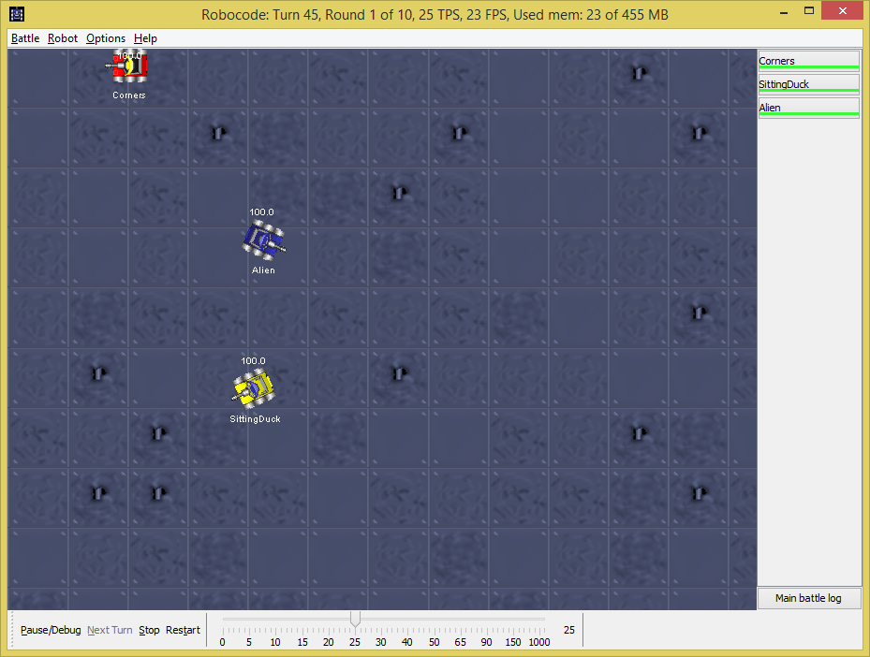
Exercise
After watching the Robocode demo in class, perform the following tasks:
Create UML class-diagrams for two objects’ classes identified in the demo
Identify at least three attributes and two methods for each class
Write the corresponding Java code of your classes
You don’t need to fully implement the methods, just write their headers.

Slide 11
Session #3
Topics
General concepts of object-oriented programming.
Preliminary concepts of structured programming.
Concepts of class, object, method, and attribute
Concepts of abstraction, encapsulation, and message passing.
UML class diagrams

